Slide 1
FPGA Lab 1
Bradley May

Slide 2
Read Loop
merged_read_norm_loop:
for (int i = 0; i < N_ROWS; i++) {
data_t row_sum = 0;
data_t local_row[N_COLS];
#pragma HLS ARRAY_PARTITION variable = local_row complete
for (int j = 0; j < N_COLS; j += 16) {
#pragma HLS pipeline II = 1 ap_uint<512> wide_access = A_WIDE_ACCESS[(i * N_COLS + j) / 16];
for (int k = 0; k < 16; k++) {
#pragma HLS unroll
unsigned int raw_bits = wide_access.range(32 * (k + 1) - 1, 32 * k);
data_t val = *(data_t *)(&raw_bits);
local_row[j + k] = val;
}
data_t chunk_sum = 0;
for (int k = 0; k < 16; k++) {
#pragma HLS unroll
chunk_sum += local_row[j + k];
}
row_sum += chunk_sum;
if (j == 48) {
ap_uint<24> denom = (ap_uint<24>)((row_sum + (data_t)1.0).range(23, 0));
ap_uint<64> one_shifted = (ap_uint<64>)1 << (35 + 14);
ap_uint<35> inv_denom = (ap_uint<35>)(one_shifted / denom);
for (int c = 0; c < N_COLS; c++) {
#pragma HLS unroll
data_t norm = division_correct(local_row[c], inv_denom, denom);
tmp[i][c] = norm;
tmp_col_sum[c] += norm;
}
}
}
}
Cast to 512-bit AXI bus
Read the 16 values in || from a 512-bit transfer
Generate adder tree for summing the 16 elements
Do normalization only once we process the last column
Division logic is covered in a later slide
I put the final-column logic inside the loop so that it could be pipelined across rows; note that the row and column loops get flattened together
Also store the rolling column sums for part 2

Slide 3
Read Loop
merged_read_norm_loop:
for (int i = 0; i < N_ROWS; i++) {
data_t row_sum = 0;
data_t local_row[N_COLS];
#pragma HLS ARRAY_PARTITION variable = local_row complete
for (int j = 0; j < N_COLS; j += 16) {
#pragma HLS pipeline II = 1 ap_uint<512> wide_access = A_WIDE_ACCESS[(i * N_COLS + j) / 16];
for (int k = 0; k < 16; k++) {
#pragma HLS unroll
unsigned int raw_bits = wide_access.range(32 * (k + 1) - 1, 32 * k);
data_t val = *(data_t *)(&raw_bits);
local_row[j + k] = val;
}
data_t chunk_sum = 0;
for (int k = 0; k < 16; k++) {
#pragma HLS unroll
chunk_sum += local_row[j + k];
}
row_sum += chunk_sum;
if (j == 48) {
ap_uint<24> denom = (ap_uint<24>)((row_sum + (data_t)1.0).range(23, 0));
ap_uint<64> one_shifted = (ap_uint<64>)1 << (35 + 14);
ap_uint<35> inv_denom = (ap_uint<35>)(one_shifted / denom);
for (int c = 0; c < N_COLS; c++) {
#pragma HLS unroll
data_t norm = division_correct(local_row[c], inv_denom, denom);
tmp[i][c] = norm;
tmp_col_sum[c] += norm;
}
}
}
}
Loop runs 256*64/16 = 1024 iterations
Initiation Interval = 1
Pipeline Depth = 62
Total Cycles approx. 1086
Utilization
13,066 LUTs (70,560 avail.)
11,558 FFs (141,120 avail.)
192 DSPs (360 avail.)
= 12 for each divide x 16 unroll

Slide 4
Division Logic
Credit goes to Gemini for final logic
How I prompted it:
Very hard to test on the real thing as it goes through multiple processing steps
Instead, used small test script (that I wrote) – see below
Went back and forth pasting the output mismatch on the same simple test-cases until it worked
data_t x = (data_t)10;
data_t y = (data_t)7;
data_t ref = golden_div(x, y);
data_t got = new_div(x, y);
if (raw_bits(ref) != raw_bits(got)) {
print_case("10/7", x, y, ref, got);
}
← Simple test script. I had Gemini iterate on the new_div function.

Slide 5
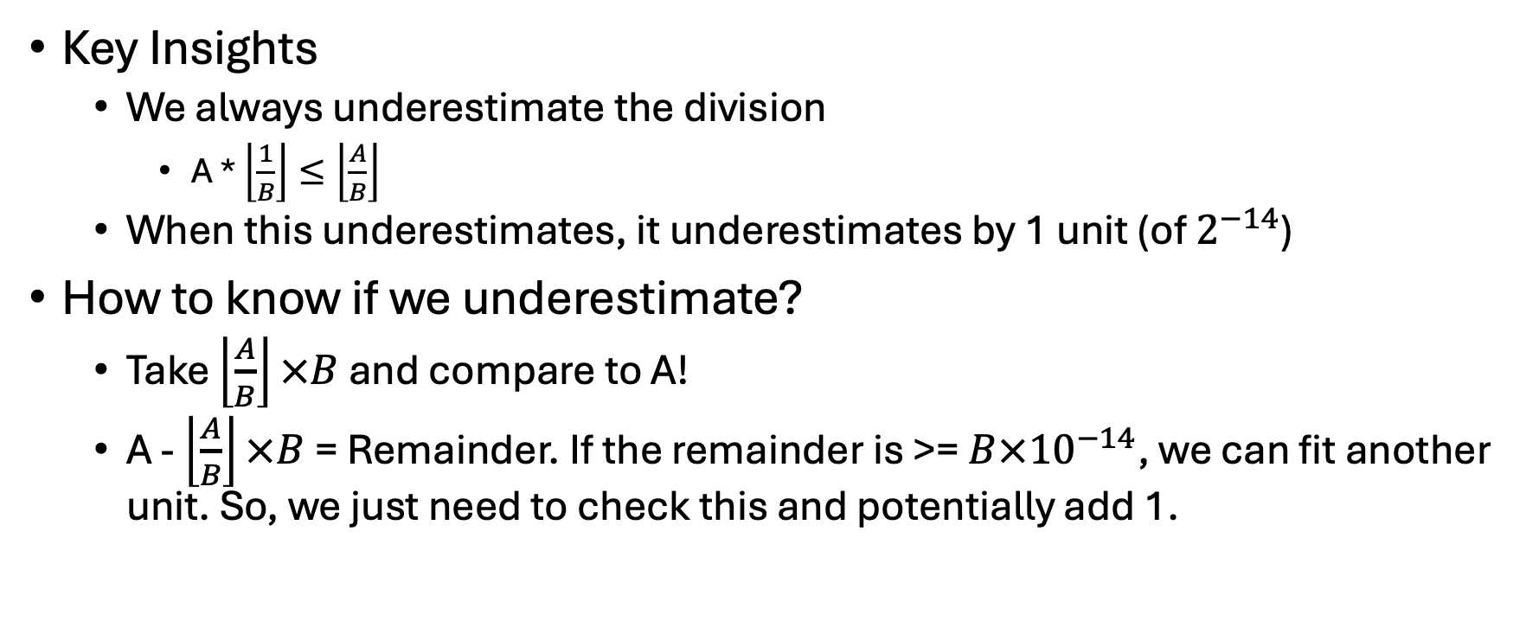
Division Logic
Key Insights
We always underestimate the division
A * $\left\lfloor \frac{1}{B}\right\rfloor ≤\left\lfloor \frac{A}{B}\right\rfloor$
When this underestimates, it underestimates by 1 unit (of $2^{−14}$)
How to know if we underestimate?
Take $\left\lfloor \frac{A}{B}\right\rfloor ×B$ and compare to A!
A - $\left\lfloor \frac{A}{B}\right\rfloor ×B$= Remainder. If the remainder is >= $B×{10}^{−14}$, we can fit another unit. So, we just need to check this and potentially add 1.

Slide 6
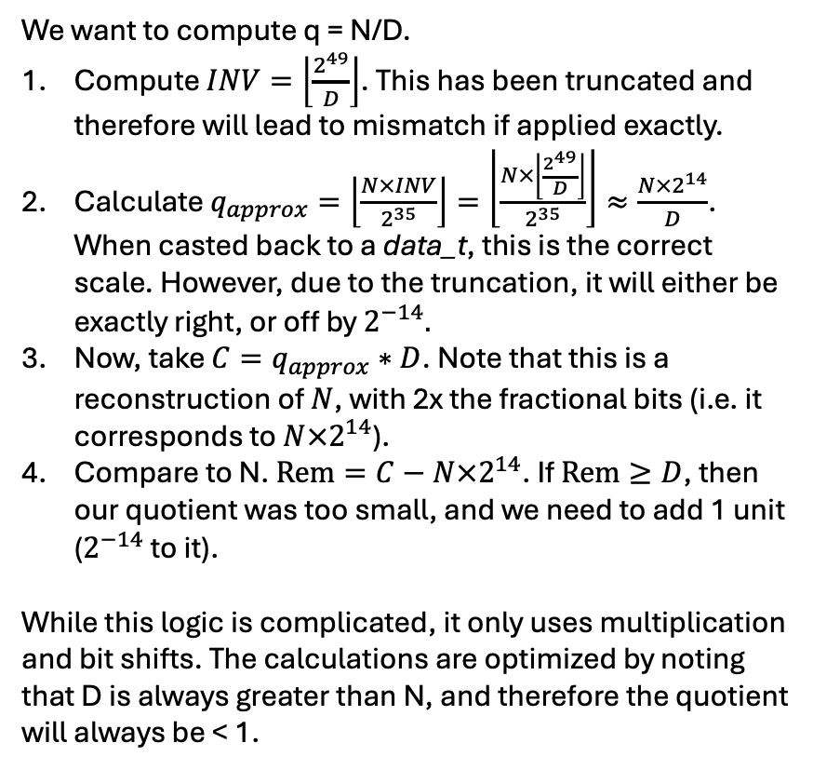
Division Logic
We want to compute q = N/D.
Compute $INV=\left\lfloor \frac{2^{49}}{D}\right\rfloor$. This has been truncated and therefore will lead to mismatch if applied exactly.
Calculate $q_{approx}=\left\lfloor \frac{N×INV}{2^{35}}\right\rfloor =\left\lfloor \frac{N×\left\lfloor \frac{2^{49}}{D}\right\rfloor }{2^{35}}\right\rfloor ≈\frac{N×2^{14}}{D}$. When casted back to a data_t, this is the correct scale. However, due to the truncation, it will either be exactly right, or off by $2^{−14}.$
Now, take $C=q_{approx}∗D$. Note that this is a reconstruction of $N$, with 2x the fractional bits (i.e. it corresponds to $N×2^{14}$).
Compare to N. $Rem=C−N×2^{14}$. If $Rem≥D$, then our quotient was too small, and we need to add 1 unit ($2^{−14}$ to it).
While this logic is complicated, it only uses multiplication and bit shifts. The calculations are optimized by noting that D is always greater than N, and therefore the quotient will always be < 1.
data_t division_correct(data_t numerator, ap_uint<35> inv_denom, ap_uint<24> denom) {
#pragma hls inline
ap_uint<24> num_int = (ap_uint<24>)(numerator.range(23, 0));
ap_uint<64> wide_product = num_int * inv_denom;
ap_uint<24> q = (ap_uint<24>)(wide_product >> 35);
ap_uint<17> q_short = (ap_uint<17>)q;
ap_uint<64> check_mul = (ap_uint<64>)q_short * (ap_uint<64>)denom;
ap_uint<64> num_int_shifted = (ap_uint<64>)num_int << 14;
ap_uint<64> rem = num_int_shifted - check_mul;
if (rem >= denom)
q++;
data_t result;
result.range(23, 0) = q;
return result;
}

Slide 7
Write Loop
merged_scale_write_loop:
for (int i = 0; i < N_ROWS; i++) {
for (int j = 0; j < N_COLS; j += 16) {
#pragma HLS pipeline II = 1
ap_uint<512> wide_pack;
for (int k = 0; k < 16; k++) {
#pragma HLS unroll
data_t val = tmp[i][j + k];
data_t col_sum = tmp_col_sum[j + k];
data_t res = val * (col_sum / 256);
unsigned int raw_bits = *(unsigned int *)(&res);
wide_pack.range(32 * (k + 1) - 1, 32 * k) = raw_bits;
}
C_WIDE_ACCESS[(i * N_COLS + j) / 16] = wide_pack;
}
}
Pipeline with II=1. Depth is only 4
Scale 16 at a time (fully unrolled) and write to 512-bit buffer
Write back the 512-bit buffer
Cycles for write loop: approx. 256*64/16 + 4 = 1028 => Total read+write loop cycles: 2,114. Actual cosim: 2,148.

